Slide 1






Social Media Friend Recommendation System
Name: Ashab Uddin
ID: 232002274
Dept. of CSE
Green University of Bangladesh
Presented To
Farjana Akter Jui
Lecturer
Dept. of CSE
Green University of Bangladesh

Slide 2

Algorithms Lab
GREEN UNIVERSITY OF BANGLADESH
Key Features Implemented
User Login
Send Friend Requests
Accept Friend Requests
Show all Friends
Recommend Friends using BFS
Recommend Friends using DFS

Slide 3

Algorithms Lab
GREEN UNIVERSITY OF BANGLADESH
Algorithms Used
Friend Recommendation (BFS): Suggests friends using Breadth-First Search (BFS).
Friend Recommendation (DFS): Suggests friends using Depth-First Search (DFS).

Slide 4
Algorithms Lab
GREEN UNIVERSITY OF BANGLADESH
Implemented Concept
Recommended Friend
ashab
sohel
rasel
Recommended Friend
rasel,modabbir
ashab
topu
modabbir
Recommended Friend
ashab

Slide 5
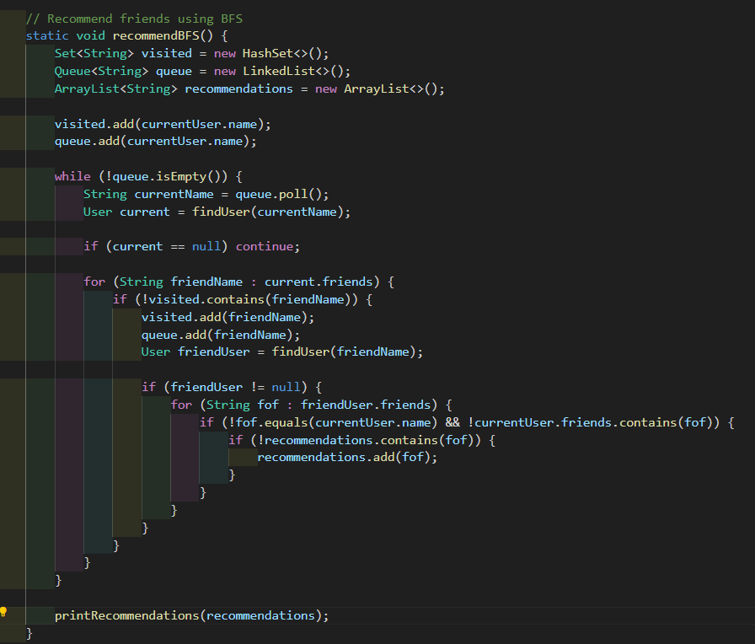
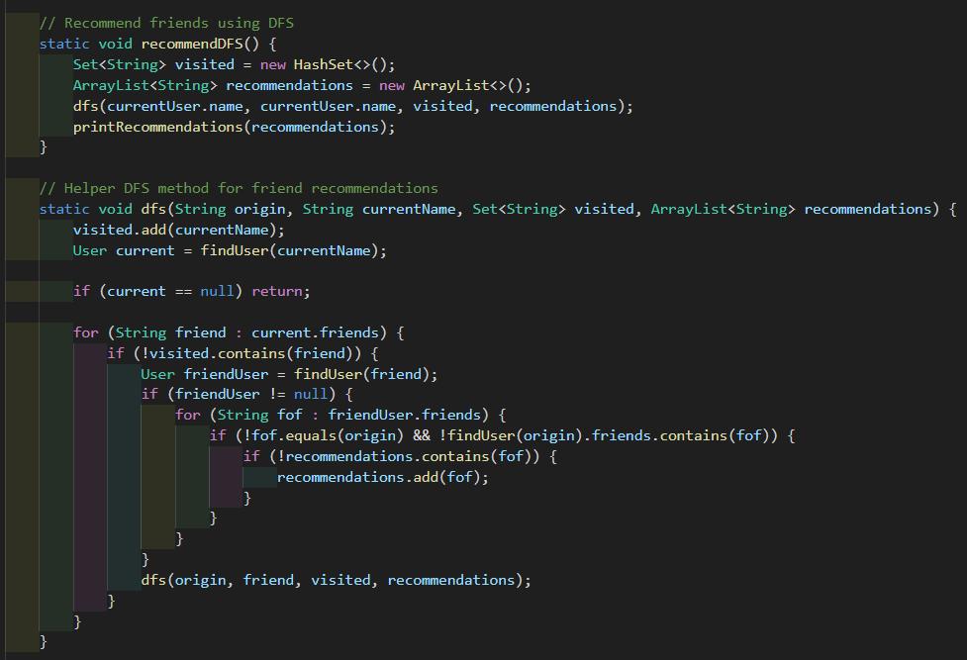
Algorithm Lab
BFS & DFS
GREEN UNIVERSITY OF BANGLADESH

Slide 6
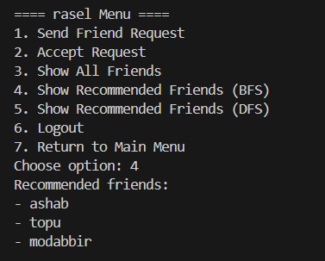
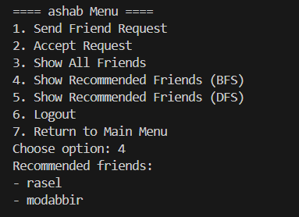
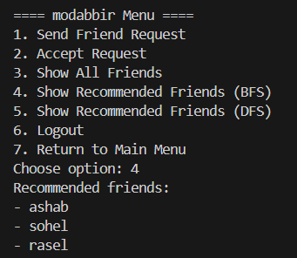
Algorithm Lab
Output
GREEN UNIVERSITY OF BANGLADESH

Slide 7


Algorithms Lab
Future Improvements & Conclusion
GREEN UNIVERSITY OF BANGLADESH
Future Improvements:
Create a Graphical User Interface (GUI).
Implement Database for data persistence.
Suggesting Friend base on Interests.

Slide 8
Algorithms Lab
GREEN UNIVERSITY OF BANGLADESH
Thank You

